Slide 1

Grocery Buddy
By Ecoders (Patrick, Raly, Kevin, Toni, and Carlo)
Notes:
Toni

Slide 2
Agenda
Process
Task Identification
Task Assignment
Individual Tasks
Notes:
Toni

Slide 3
Our Process
Break down project by page
UI elements
Functions
Indicate which elements have working prototypes
Assign tasks based on prototypes and experience
Break each task into 1-2 hour sub tasks
Notes:
Patrick

Slide 4
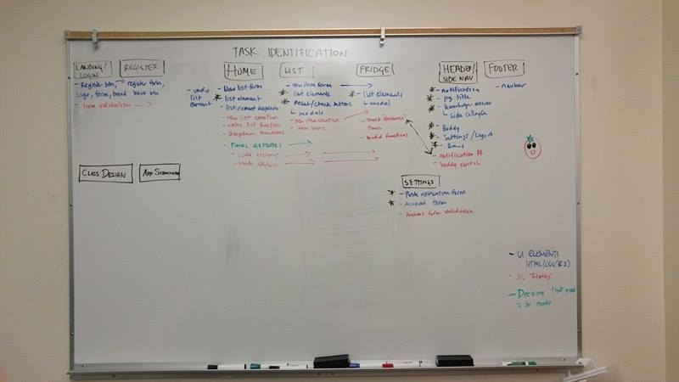
Task Identification
Notes:
Kevin

Slide 5
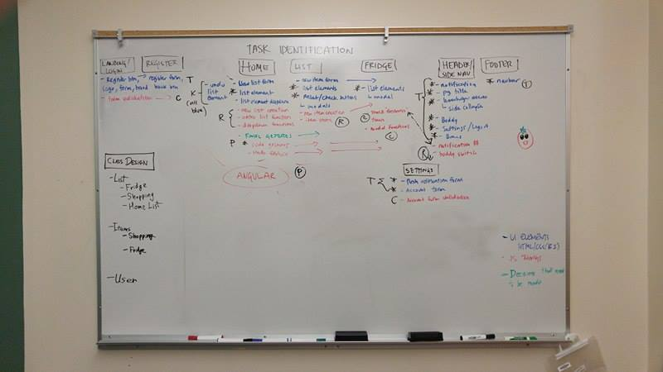
Task Assignment
Notes:
Kevin

Slide 6
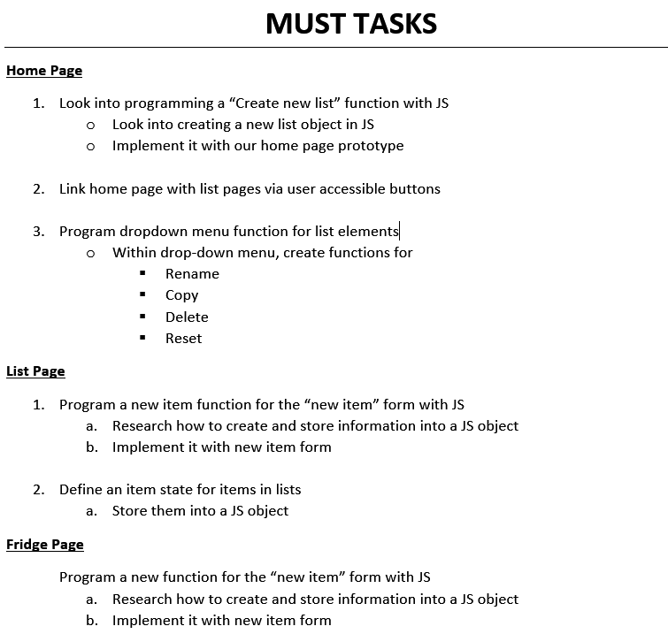
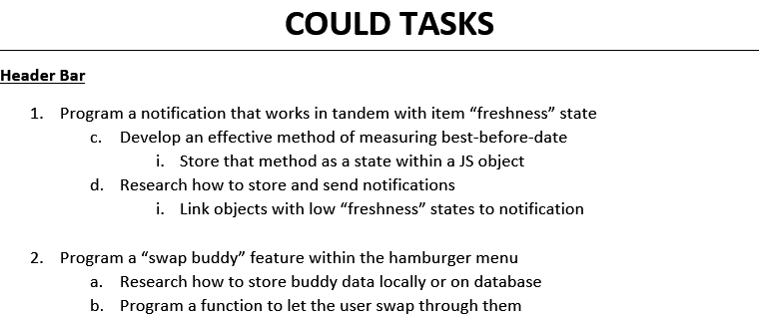
Individual Tasks
Notes:
Raly

Slide 7
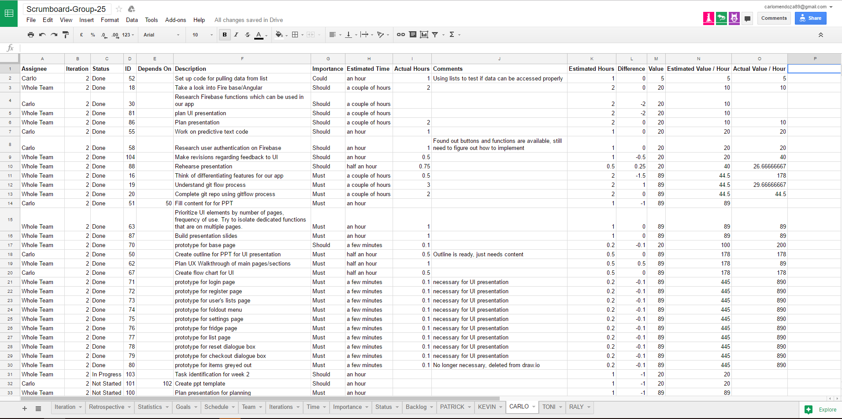
Scrumboard Tasks
Notes:
Carlo

Slide 8

Our Scrumboard
Click here!

Slide 9

Sprint #1 Challenge
Click here!

Slide 10

Q&A
Questions?
Notes:
Toni

Slide 11




Conclusion
THANKS!
Notes:
Toni

